Slide 1
Comp 246: Object Oriented Software Engineering
Parking Management System
Aesha Bhatt 301034022
Minh Chau Hoang 300946197
Xiaohui Hao 300878632
Gaofeng Pan 300973143
Carlos Zabaleta 301002235

Slide 2
Main idea
College Parking Application is a mobile app which gives the facility to the students and employees to have all the information related to the College Parking as payments, real-time parking slot availability and the car’s pick up location.

Slide 3
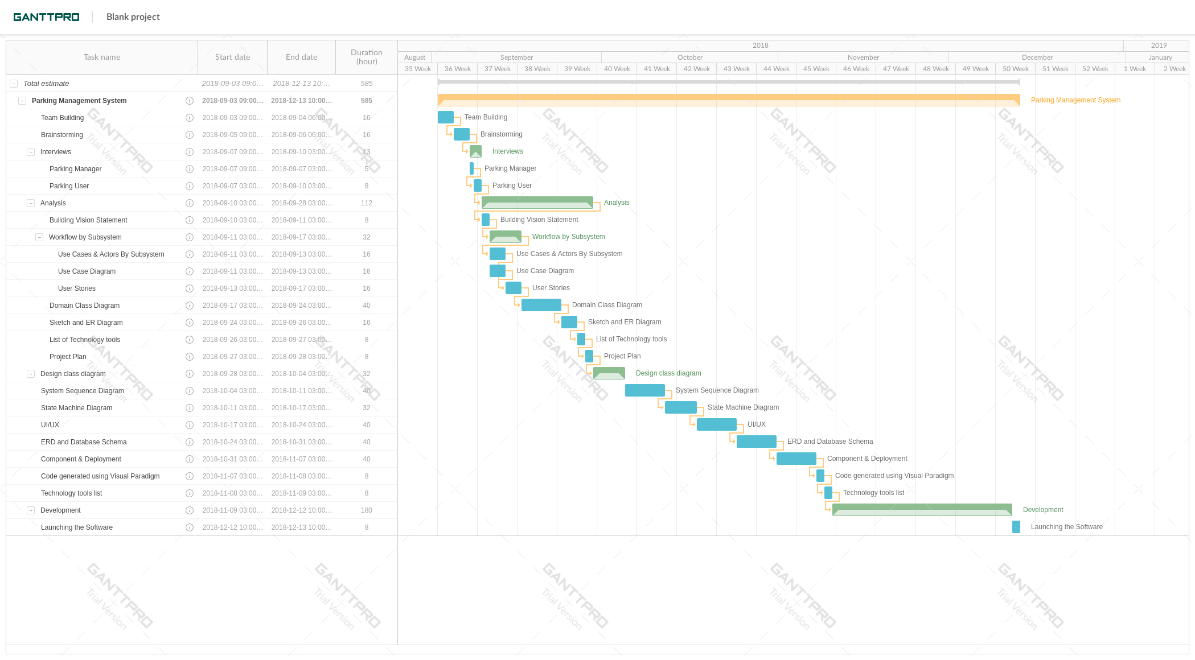
Work Breakdown Structure:

Slide 4
Business Benefits:
Reduce the time in finding a parking slot at college.
Improves quality of services on the campus.
Provide integrity in management system of college.

Slide 5
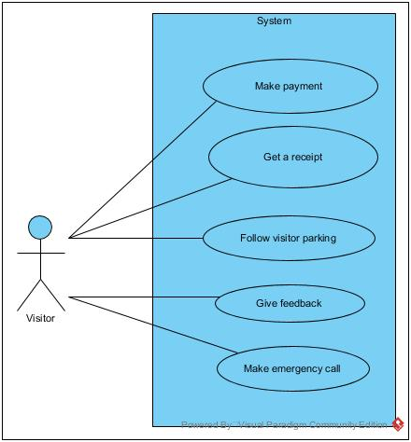
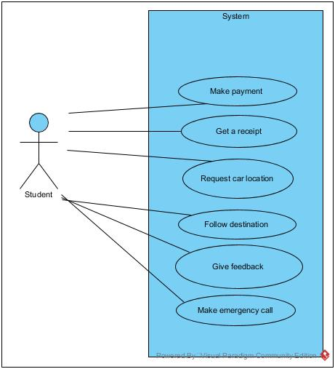
Use case diagrams:

Slide 6
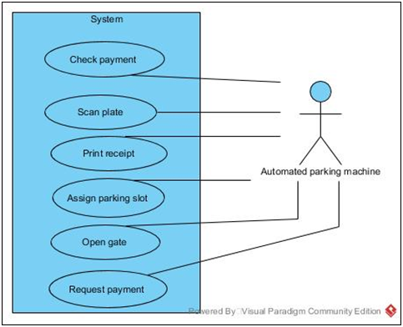
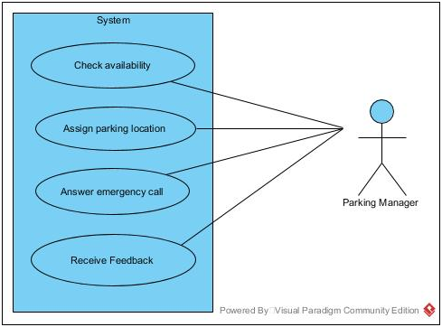
Use Case diagrams:

Slide 7
Users Stories
Use Case | User Story | Acceptance Criteria
Follow Returned Location | As a student/employee, I want to follow the navigation to an empty slot on my phone screen | 1. The APP should be installed, required rights should be given. 2. 4G Internet is required. 3. GPS chips in the phone are needed. 4. Maps of the parking lot are highly accurate. 5. Customer account information and car plate should be stored on the database. 6. Two states of slot “occupied” “empty” should be dynamic real-time updated on the database.
Add Payment | As a student/employee, I want to add payment automatically. | 1. Customer account information and car plate should be stored on the database. 2. Gate camera should scan plate and identify the customer. 3. Check time and cut money from prepayment account automatically.
Add Feedback | As a student/employee, I want to add feedback or make an emergency call. | 1. Words or pieces of voice can be recorded in APP for feedback. 2. The emergency call can be made by mobile or through phones which are installed at every gate of the parking lot.
Receive Feedback | As a parking manager, I want to receive feedback in APP | 1. Feedback can be a list in the database server.
Provide Customer Service | As a parking manager, I want to answer a customer’s emergency call and provide customer service. | 1. Customer’s current location should be displayed to the manager as soon as the emergency call is connected.
Make Payment | As a visitor, I want to make payment in payment machine. | 1. The visitor has own parking area. 2. The state of the slot in the visitor area is not controlled by the database system. 3. Visitor parking area provides payment machine and accessing card. 4. Figure out parking time by inserted accessing card picked up when entering.

Slide 8
Users Stories
Student
Make payment
As a student/employee, I want to make a payment at the beginning of the semester so that I can park my car in the parking area.
Get a receipt
As a student/employee, I want to get a receipt for the payment I have made so that I can have a proof of my payment.
Request car location
As a student/employee, I want to ask for the location of my car so that I find my car.
Follow destination
As a student/employee, I want to follow the direction to an empty slot on my phone screen so that I can park my car.
Give feedback
As a student/employee, I want to give feedback so that I can give my opinion of the service.
Make emergency call
As a student/employee, I want to make an emergency call so that I can report an emergency.

Slide 9
Users Stories
Visitor
Ask for parking area
As a visitor, I want to inquire for the visitor parking area so that I can park my car.
Follow visitor parking
As a visitor, I want to follow the direction for the visitor parking area so that I can park my car.
Makes payment
As a visitor, I want to make a payment when I leave so that I can leave the parking area.
Get a receipt
As a visitor, I want to get a receipt for the payment I have made so that I can have a proof of my payment.
Give feedback
As a visitor, I want to give feedback or make an emergency call so that I can give my opinion of the service.
Make emergency call
As a visitor, I want to make an emergency call so that I can report an emergency.

Slide 10
Users Stories
Automated parking machine
Scan plate
As an automated parking machine, I want to scan the car’s plate so that I can check if the customer is eligible to park.
Check payments
As an automated parking machine, I want to check if the customer made a payment so that I can check if the customer has any previous holds.
Assign parking slot
As an automated parking machine, I want to assign a nearby parking slot to the customer so that I can help the customer where to park.
Print receipt
As an automated parking machine, I want to print the receipt for the visitor so that the visitor can complete the payment.

Slide 11
Users Stories
Parking Manager
Receive feedback
As a parking manager, I want to receive feedback so that I can help the customer.
Check availability
As a parking manager, I want to check the availability of a parking slot so that I can assist the visitor.
Assign parking location
As a parking manager, I want to assign an available parking slot to the visitor so that he can park his car.
Answer emergency call
As a parking manager, I want to receive feedback so that I can help the customer.

Slide 12
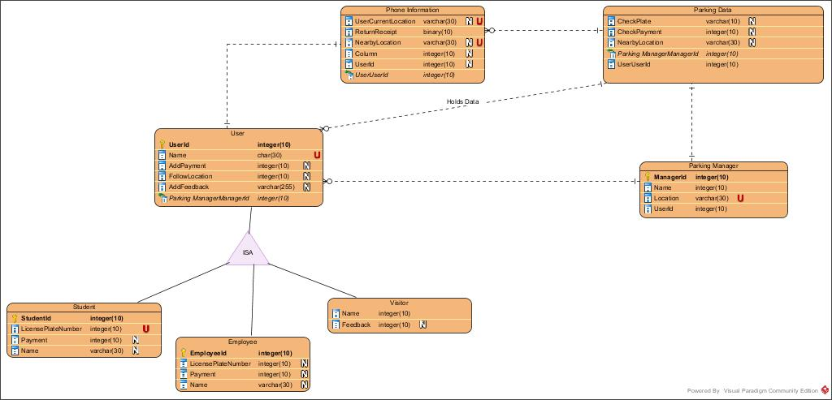
ERD

Slide 13
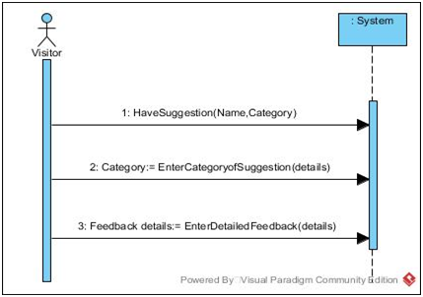
System Sequence Diagrams:
1) Visitor System Sequence Diagram for
adding suggestion

Slide 14
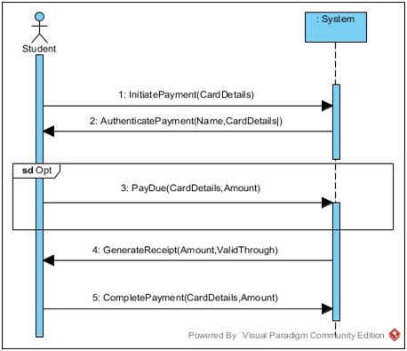
2) Student System Sequence Diagram for
making Payment

Slide 15
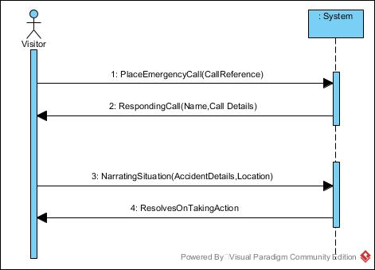
3) Visitor System Sequence Diagram for
placing emergency Call

Slide 16
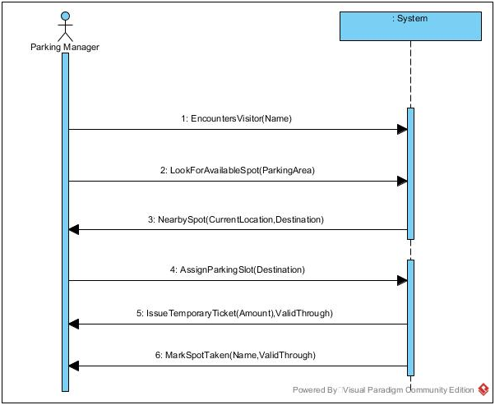
4) Parking Manager System Sequence Diagram
for assigning parking to visitor

Slide 17
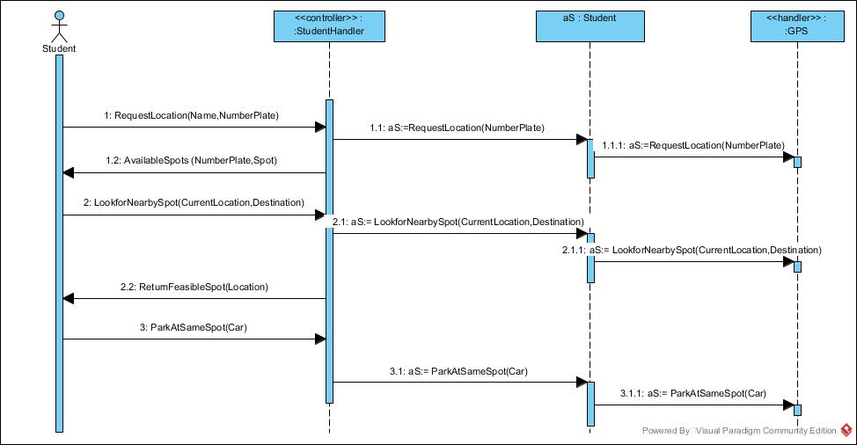
Sequence Diagrams:
Student Sequence Diagram
for Requesting Car Location

Slide 18
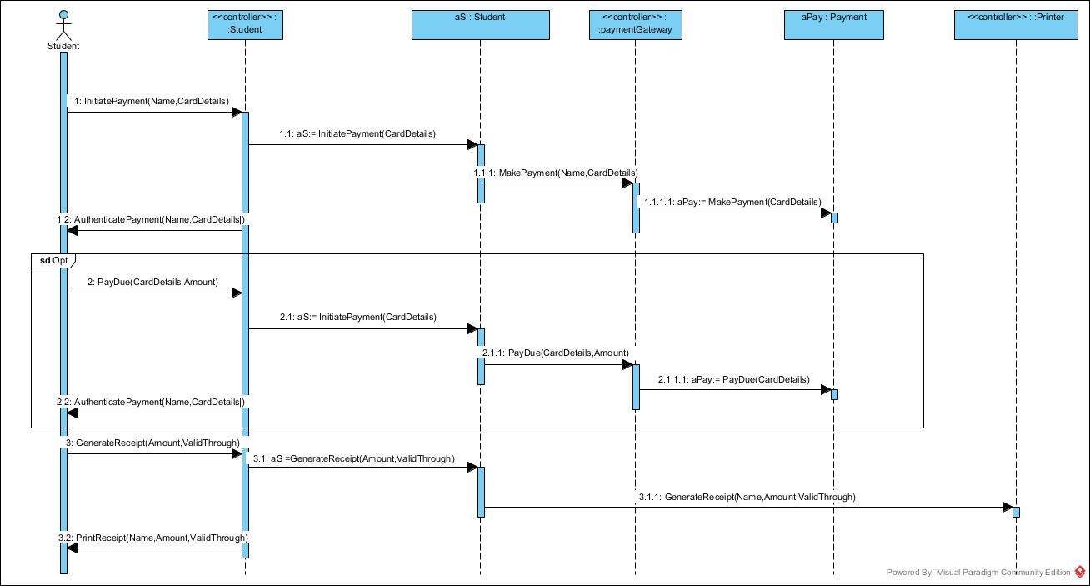
Sequence
Diagram
Student Sequence
Diagram to Get Receipt

Slide 19
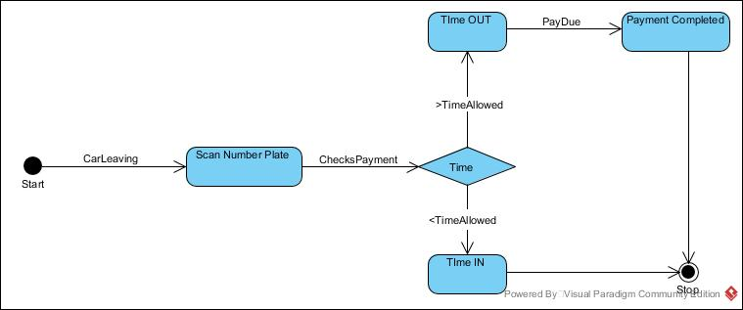
State Machine Diagram:
State Machine Diagram that checks Due Payment

Slide 20
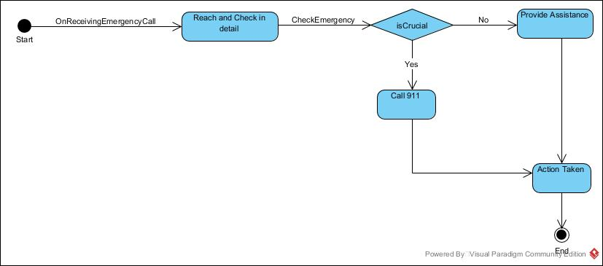
State Machine Diagram:
State Machine Diagram for Emergency Call- Parking Manager

Slide 21
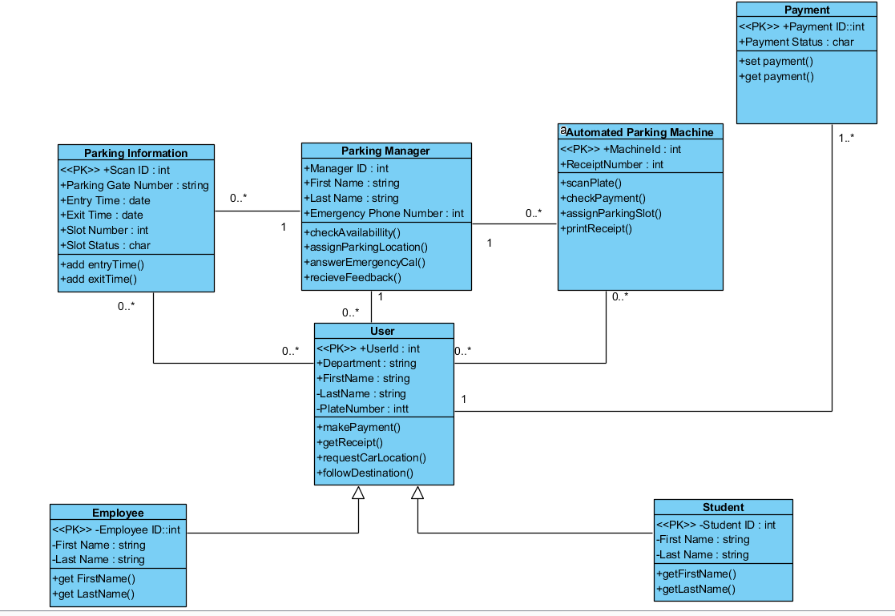
Detail class diagram

Slide 22
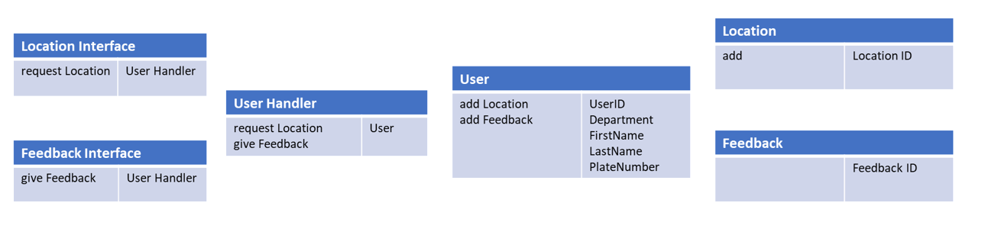
CRC Cards

Slide 23
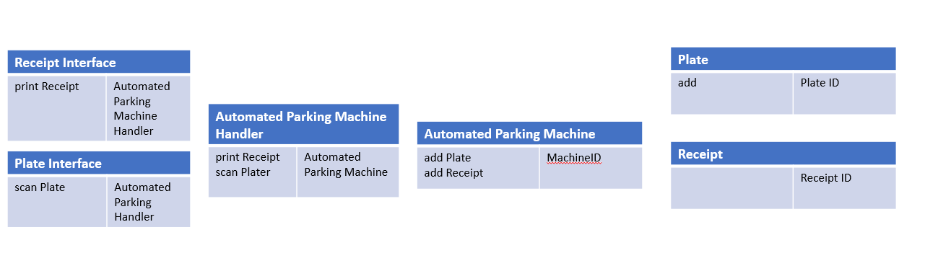
CRC Cards

Slide 24
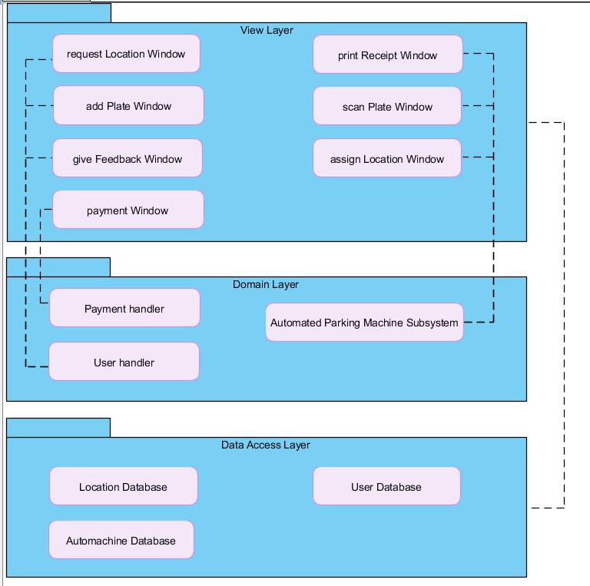
Package Diagram
Dependencies:
View layer depends on Data Access layer
RequestLocationWindow, AddPlateWindow, GiveFeedbackWindow depends on User Handler
Payment Window depends on Payment Handler
PrintReceiptWindow, ScanPlateWindow, AssignLocationWindow depends on Automated Parking Machine Subsystem

Slide 25
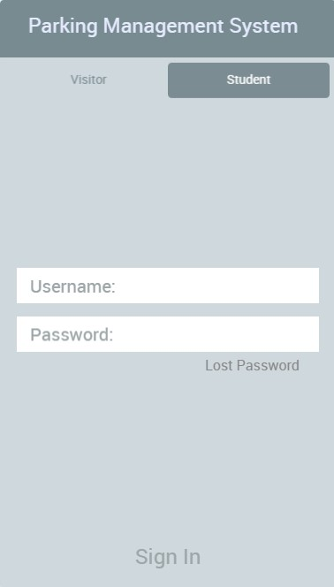
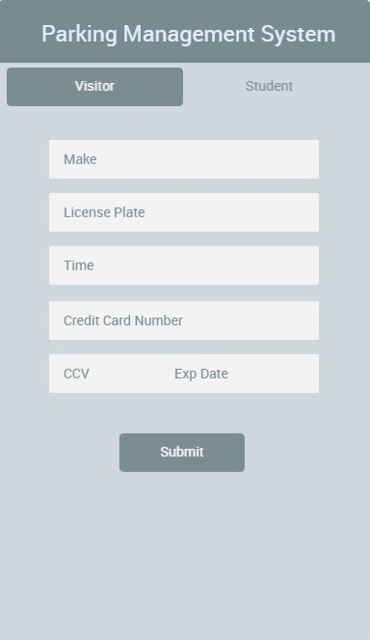
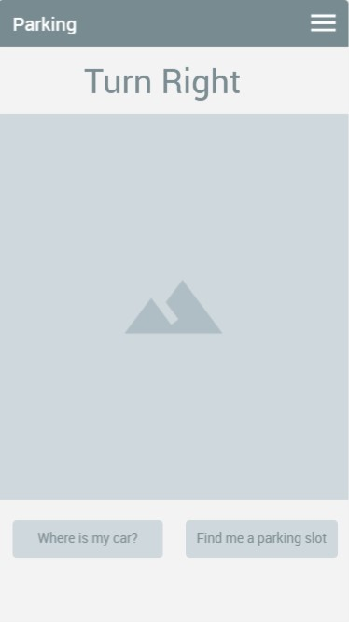
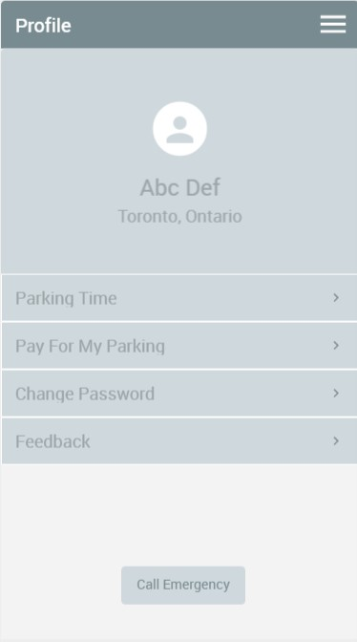
User interface

Slide 26
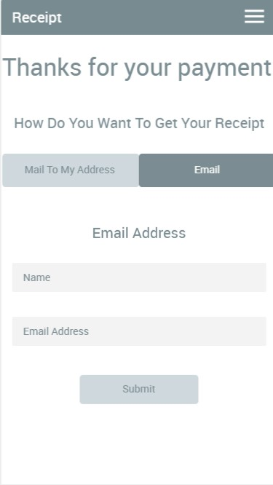
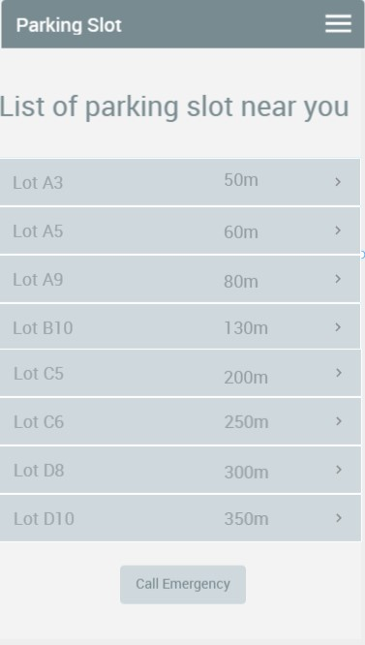
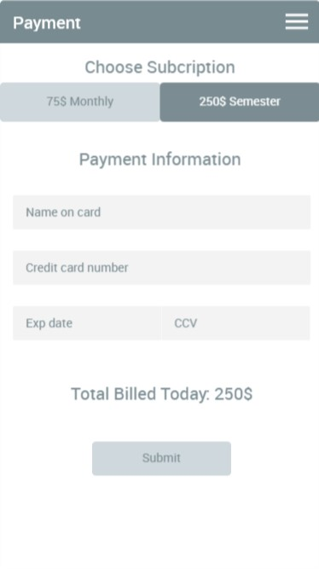
User Interface

Slide 27
Technology tools
Software
Visual Paradigm
Microsoft Project
Office 2016
Photoshop
GanttPro
Oracle SQLDeveloper

Slide 28
Lesson Learned ...

